Slide 1

INSTITUTE :UIE
DEPARTMENT: ALL ACADEMIC UNITS
Bachelor of Engineering (All Sections)
Subject Name and Code:
Engineering Physics 23SPH-141
Prepared by: Ms. Arminder
UNIT 3
QUANTUM MECHANICS
DISCOVER . LEARN . EMPOWER

Slide 2
COURSE OBJECTIVES
The course is designed to make the students industry ready to contribute in the growing demand of the industry at local, national and international level.
It will make the students competent to understand basic concepts and applications of advanced engineering physics and apply its principles in their respective fields at global platform.
It will enhance the skill level of the students and shall make them preferred choice for getting employment in industry and research labs.
It will give thorough knowledge of the discipline to enable students to disseminate knowledge in pursuing excellence in academic areas.

Slide 3

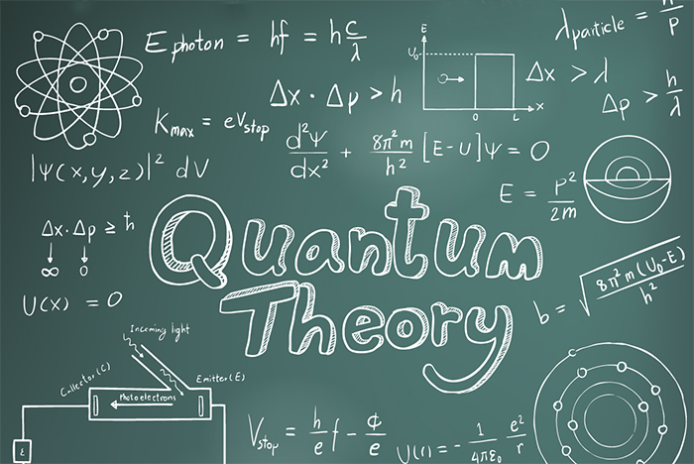
COURSE OUTCOME
CO Number | Title On completion of this course, the students are expected to learn | Level
CO1 | Quote the basic fundamental concepts of lasers, optical fibres, crystallography, ultrasonic oscillations, semiconductor physics, quantum mechanics and nanotechnology. | Remember, Understand
CO2 | Demonstrate the working of various lasers, fibre components, semiconductor devices; explain the behaviour of crystalline solids, quantum and nano-scale systems. | Understand
CO3 | Solve problems by applying principles related to lasers, fibres, semiconductors, oscillations, quantum and nanoscience. | Applying
CO4 | Compare various lasers and fibres, semiconducting devices, crystalline materials, structures at quantum and nanoscale on the basis of their properties for industrial applications. | Analyze
CO5 | Develop various systems using lasers, fibres, semiconductors and nanomaterials for futuristic applications. | Design
Figure 1 Quantum Theory [1]

Slide 4
LECTURE OBJECTIVE
1
Students will learn about Phase and group velocity.
2
Students will learn about relation between Phase and group velocity
3
In this lecture will derive relation between Phase and group velocity .

Slide 5
QUANTUM MECHANICS
Figure 3.1 Quantum Theory [1]

Slide 6
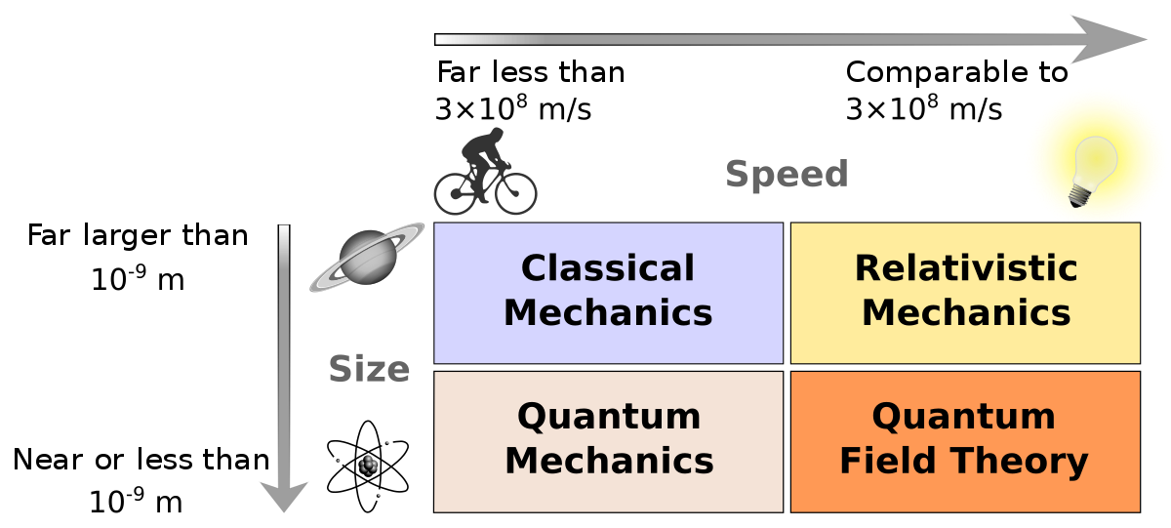
NEED OF QUANTUM MECHANICS
Problems remained from classical mechanics that relativity didn’t explain
Attempts to apply the laws of classical physics to explain the behavior of matter on the atomic scale were consistently unsuccessful.
Figure 3.2 Need of Quantum Theory [2]

Slide 7
NEED OF QUANTUM MECHANICS
Problems included:
Blackbody radiation
The electromagnetic radiation emitted by a
heated object
Photoelectric effect
Emission of electrons by an illuminated metal
Figure 3.2 Need of Quantum Theory [2]

Slide 8

GROUP VELOCITY AND PHASE VELOCITY
Group velocity: The velocity with which the wave packet- which is formed due to the superposition of two or more waves of slightly different wavelengths is transmitted is called as group velocity.
(OR)
It is the velocity with which resultant wave packet formed due to the superposition of two or more waves propagates.
Phase velocity: If a point is imagined to marked on a traveling wave, then it becomes a representative point for a particular phase of the wave, and the velocity with which it is transported is called phase velocity
(OR)
It is the velocity with which the individual waves forming the wave packet propagates.
V_{p=}ω/k

Slide 9
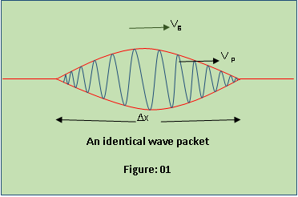
GROUP VELOCITY AND PHASE VELOCITY
Figure 3.3: Wave packet[3]

Slide 10
HOW THE CONCEPT OF PHASE AND GROUP VELOCITY ARISES?
According to the theory of relativity particle velocity (v) is always less than the speed of light c. As per De-Broglie concept, wave velocity must be greater than c. This is an unexpected result. According to this the de-Broglie wave associated with the particle would travel faster than the particle itself, thus leaving the particle far behind. The difficulty was recovered by Schrödinger by postulating that a material particle in motion is equivalent to a wave packet rather than a single wave.
Wave packet comprises of a group of waves, each with slightly different velocity
And wavelength. Such a wave packet moves with its own velocity v_{g­}, called the
group velocity.
The individual wave forming the wave packet possesses an average velocity, vp
called the phase velocity.
I velocity of the material particle v is the same as group velocity

Slide 11
Relation Between Phase and Group velocity

Slide 12
SUMMARY
Group velocity corresponds to velocity of wave packet.
Wave packet consist of no. of waves.
Phase velocity corresponds to individual wave.
velocity of the material particle v is the same as group velocity.

Slide 13
FAQ
Prove that velocity of the material particle v is the same as group velocity.
Define phase and group velocity.
Derive relation between phase and group velocity.

Slide 14
REFERENCES
[1] https://stradallc.com/2016/02/12/design-like-quantum-physics/
[2] https://en.wikipedia.org/wiki/Branches_of_physics
[3] http://www.sciencecalculators.org/optics/light/
[4] https://pediaa.com/wp-content/uploads/2016/04/Difference-Between-Phase-Velocity-and-Group-Velocity-image-11.png

Slide 15
REFERENCES
Video link
https://www.youtube.com/watch?v=_VeTwdGZY_Y
https://www.youtube.com/watch?v=tlM9vq-bepA
Books
Concepts of Modern Physics, (Fifth Edition) A Beiser, McGraw Hill International.
Fundamentals of Physics, David Halliday, Robert Resnick and Jearl Walker, Wileyplus

Slide 16
THANK YOU
arminder.uis@cumail.in

